Slide 1


Slide 2
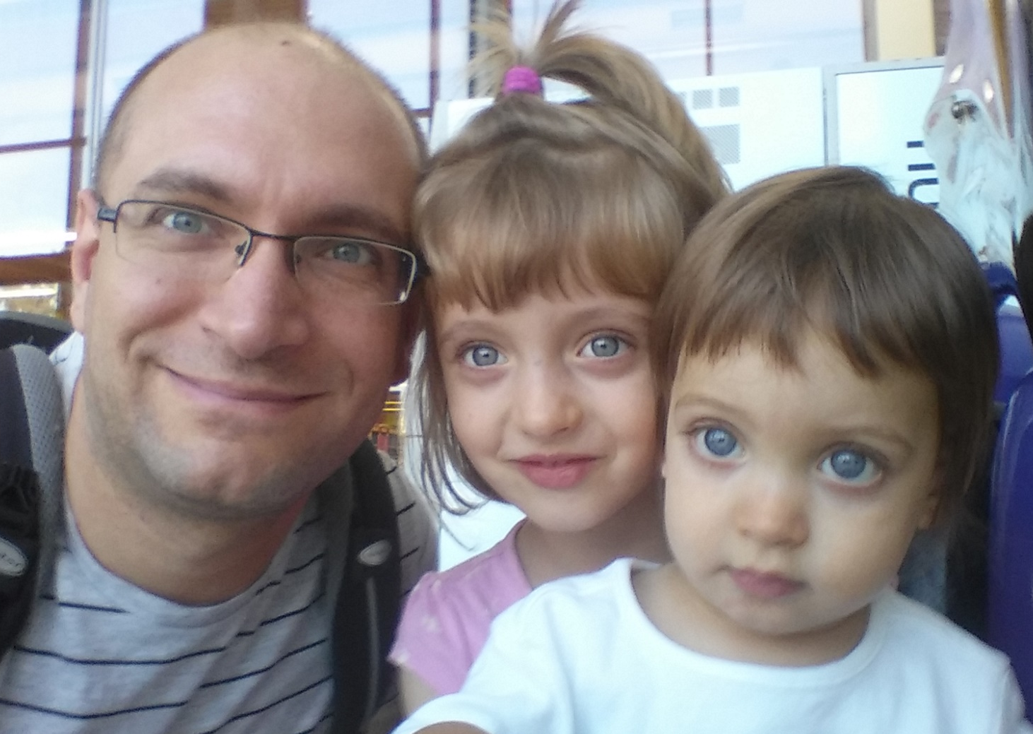


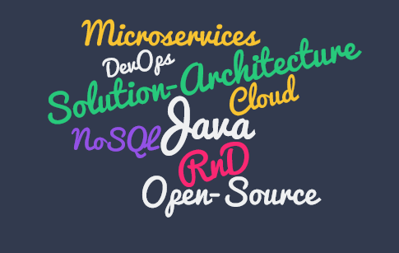

Who am I?
Oresztész Margaritisz
@gitaroktato
maoreszt

Slide 3
What is DC/OS?
Operating system for your datacenter

Slide 4
Why DC/OS?
Distributed computing is hard and error-prone
10,000 nodes impossible for humans
Custom solutions are expensive
Cloud agnosticity is very hard

Slide 5


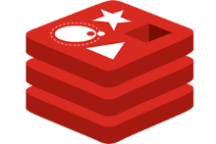
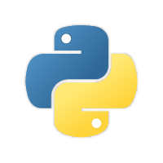


Why DC/OS?

Slide 6

Why DC/OS?

Slide 7
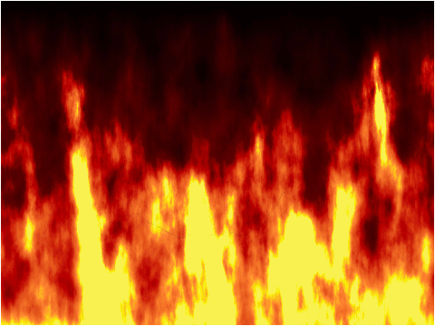



Why DC/OS?

Slide 8
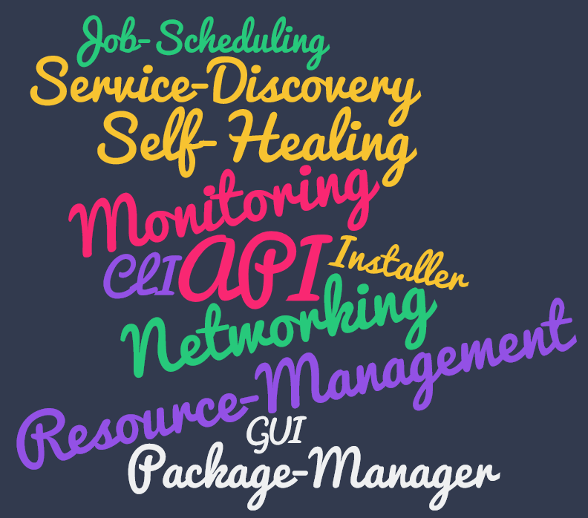
Key Features

Slide 9



10,000 foot view
AWS
Networking
Azure
Orchestration
Google Cloud
Monitoring
Service Registry
Bare Metal

Slide 10
10,000 foot view
User Space
process
process
service
process
service
service
process
process
process
System Components
Kernel Space
Mesos Agent
Mesos Agent
Mesos Agent
Mesos Agent
Mesos Master
Mesos Master
Mesos Master

Slide 11


zk
zk
Hadoop scheduler
Marathon scheduler
zk
Mesos Master
Standby Master
Standby Master
Mesos Agent
Mesos Agent
Mesos Agent
Hadoop executor
Marathon executor
Hadoop executor
Marathon executor
task
task
task
task

Slide 12

Framework 1
Framework 2
Job 1
Job 2
Job 1
Job 2
FW Scheduler
FW Scheduler
<s1, 4cpu, 4gb … >
2
3
<task1, s1, 2cpu, 1gb … >
<task2, s1, 1cpu, 2gb … >
Mesos Master
<s1, 4cpu, 4gb … >
1
4
<fw1, task1, 2cpu, 1gb … >
<fw1, task2, 1cpu, 2gb … >
Mesos Agent
Mesos Agent
Executor
Task
Task

Slide 13


MARATHON

Slide 14
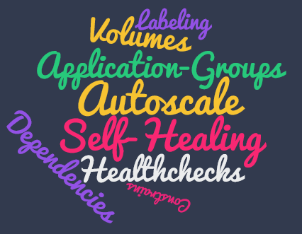
MARATHON

Slide 15

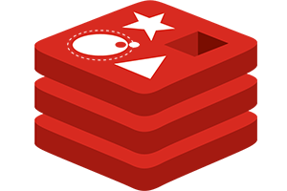
Demo

Slide 16


Slide 17


